Slide 1
More XML

Slide 2
Overview
Namespaces
Displaying XML documents
  With CSS
  XSLT style sheets
XML Processors
  SAX and DOM approach
Web Services

Slide 3
Namespaces
A markup vocabulary is the collection of all of the element types and attribute names of a markup language (a tag set)
An XML document may define its own tag set and also use those of another tag set - CONFLICTS!
An XML namespace is a collection of element names used in XML documents
  The name of an XML namespace has the form of a URI

Slide 4
Namespaces
A namespace declaration has the form:
<element_name xmlns[:prefix] = URI>
The prefix is a short name for the namespace, which is attached to names from the namespace in the XML document
<gmcars xmlns:gm = "http://www.gm.com/names">
  In the document, you can use <gm:pontiac>
Purposes of the prefix:
1. Shorthand
2. URI includes characters that are illegal in XML

Slide 5
Namespaces
Can declare two namespaces on one element
<gmcars xmlns:gm = "http://www.gm.com/names"
xmlns:html = "http://www.w3.org/1999/xhtml">
The gmcars element can now use gm names and html names
One namespace can be made the default by leaving the prefix out of the declaration

Slide 6
Displaying Raw XML Documents
There is no presentation information in an XML document
An XML browser should have a default style sheet for an XML document that does not specify one
  You get a stylized listing of the XML, e.g.:
  http://www.crg.cs.nott.ac.uk/~bnk/Teaching/WPS/planes.xml
It is unusual to display a raw XML doc.

Slide 7
Displaying XML Documents with CSS
A CSS style sheet for an XML document is just a list of its tags and associated styles
The connection of an XML document and its style sheet is made through an xml-stylesheet processing instruction
<?xml-stylesheet type = "text/css" href = "mydoc.css"?>
http://www.crg.cs.nott.ac.uk/~bnk/Teaching/WPS/planes.css
http://www.crg.cs.nott.ac.uk/~bnk/Teaching/WPS/planes1.xml

Slide 8
eXtensible Stylesheet Language (XSL)
XSL began as a standard for presentations of XML documents
Split into three parts:
  XSL (XSL-FO) – Formatting objects
  XSLT – Transformations
    XSLT stylesheets are used to transform XML documents into different forms or formats
    e.g. transform XML doc to XHTML doc for display
  XPATH - XML Path Language
    An XML document is a tree made up of nodes
    XPath is a language for identifying nodes and sets of nodes out of this tree

Slide 9
XSLT Style Sheets
XSLT is a functional style programming language
Syntactic structure is XML
  Each statement specified with an element
  Appears very different from programs in typical programming languages

Slide 10
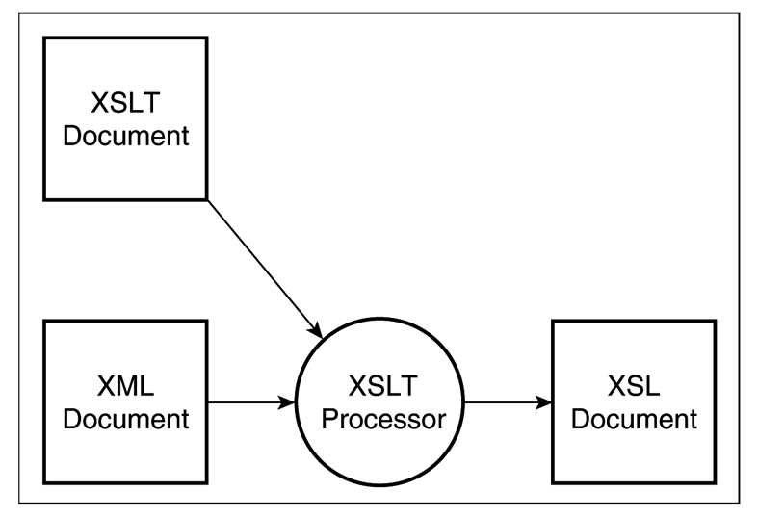
XSLT Style Sheets
An XSLT processor merges an XML document into an XSLT style sheet
  This merging is a template-driven process
  Each template uses XPath to describe element patterns in the XML doc to be processed
An XSLT style sheet can specify page layout, page orientation, writing direction, margins, page numbering, etc.

Slide 11
XSLT Style Sheets
The processing instruction we used for connecting a CSS style sheet to an XML document is used to connect an XSLT style sheet to an XML document
<?xml-stylesheet type = "text/xsl" href = "XSLT style sheet"?>
An XSLT style sheet is an XML document with a root element, stylesheet, which defines namespaces
<xsl:stylesheet xmlns:xsl = "http://www.w3.org/1999/XSL/Format“ xmlns ="http://www.w3.org/1999/xhtml">

Slide 12
XSLT Style Sheets
An XSLT stylesheet must include at least one template element
  Includes a match attribute to specify an XPath expression to select a node in the XML doc
  Content of template element specifies what is to be placed in the output document
  E.g. to match the root node of the XML doc:
  <xsl:template match = "/"> …
or <xsl:template match = “plane”>
<html><head><title>Example</title>…
</xsl:template>

Slide 13
XSLT Style Sheets
Stylesheets usually have templates for nodes that are descendants of the root node
<xsl:template match = “year”>
XPath expressions beginning with ‘/’ are absolute
Otherwise they are relative to the “current” node of the XML document
  The last node found by the XSLT processor
Template for root node is implicitly applied but all others must be explicitly applied with apply-templates element

Slide 14
XSLT Style Sheets
Template elements include two distinct kind of elements
  Those that literally contain content
    often represent XHTML elements
  Those that specify content to be copied from the XML doc
    Done with the XSLT value-of element
    Uses a select attribute to specify the element of the XML doc. whose contents are to be copied
    <xsl:value-of select = ”AUTHOR" />
    Has no content
    The value of select can be any node of the XML document tree

Slide 15
XSLT Style Sheets
Simple XML doc and XSLT style sheet
http://www.crg.cs.nott.ac.uk/~bnk/Teaching/WPS/xslplane.xml
http://www.crg.cs.nott.ac.uk/~bnk/Teaching/WPS/xslplane1.xsl
http://www.crg.cs.nott.ac.uk/~bnk/Teaching/WPS/xslplane2.xsl
The XSLT for-each element
  Used when an XML document has a sequence of the same elements
http://www.crg.cs.nott.ac.uk/~bnk/Teaching/WPS/xslplanes.xml
http://www.crg.cs.nott.ac.uk/~bnk/Teaching/WPS/xslplanes.xsl
XSLT tutorial and more examples
http://www.w3schools.com/xsl/default.asp

Slide 16
XML Processors
Purposes:
  Check the syntax of a document for well-formedness
  Replace all references to entities by their definitions
  Copy default values (from DTDs or schemas) into the document
  If a DTD or schema is specified and the processor includes a validating parser, the structure of the document is validated
Two ways to check well-formedness:
  A browser with an XML parser
  A stand-alone XML parser

Slide 17
SAX (Simple API for XML)
Widely accepted and supported approach
Based on the concept of event processing:
  Every time a syntactic structure (e.g., a tag, an attribute, etc.) is recognized, the processor raises an event
The application defines event handlers to respond to the syntactic structures

Slide 18
The DOM Approach
The DOM processor builds a DOM tree structure of the document
  Similar to the processing by a browser of an XHTML document
  When the tree is complete, it can be traversed and processed

Slide 19
The DOM Approach
Advantages of the DOM approach:
  Good if any part of the document must be accessed more than once
  If any rearrangement of the document must be done, it is facilitated by having a representation of the whole document in memory
  Random access to any part of the document is possible
  Because the whole document is parsed before any processing takes place, processing of an invalid document is avoided
Disadvantages of the DOM approach:
  Large documents require a large memory
  The DOM approach is slower

Slide 20
Web Services
The ultimate goal of Web services:
  Allow different software in different places, written in different languages and resident on different platforms, to connect and interoperate
The Web began as provider of markup documents, served through the HTTP methods, GET and POST
  An information service system
A Web service is closely related to an information service
  Rather than having a server provide documents, the server provides services, through server-resident software
The same Web server can provide both documents and services

Slide 21
Big Web Services
The original Web services were provided via Remote Procedure Call (RPC), through two technologies, DCOM and CORBA
  DCOM and CORBA use different protocols, which defeats the goal of universal component interoperability
There are three roles required to provide and use Web services:
  Service providers
  Service requestors
  A service registry

Slide 22
Big Web Services
Web Serviced Definition Language (WSDL)
  Used to describe available services, as well as message protocols for their use
  Such descriptions reside on the Web server
Universal Description, Discovery, and Integration Service (UDDI)
  Used to create Web services registry, and also methods that allow a remote system to determine which services are available
Standard Object Access Protocol (SOAP)
  An XML-based specification that defines the forms of messages and RPCs
  Supports the exchange of information among distributed systems

Slide 23
RESTful Web Services
Gaining popularity, particularly with Internet companies
Use PUT, GET and DELETE HTTP methods, alongside POST
  often better integrated with HTTP and web browsers than SOAP-based services
They do not require XML messages or WSDL service-API definitions
  response messages, usually expressed in an XML or JavaScript Object Notation (JSON) format

Slide 24
Summary
Namespaces
Displaying XML documents
  With CSS
  XSLT style sheets
XML Processors
  SAX and DOM approach
Web Services

